Slide 1
Divide-and-Conquer Algorithms and Recurrence Relations
Section 8.3

Slide 2

Section Summary
Divide-and-Conquer Algorithms and Recurrence Relations
Examples
  Binary Search
  Merge Sort
  Fast Multiplication of Integers
Master Theorem

Slide 3

Divide-and-Conquer Algorithmic Paradigm
Definition: A divide-and-conquer algorithm works by first dividing a problem into one or more instances of the same problem of smaller size and then conquering the problem using the solutions of the smaller problems to find a solution of the original problem.
Examples:
Binary search: It works by comparing the element to be located to the middle element. The original list is then split into two lists and the search continues recursively in the appropriate sublist.
Merge sort: A list is split into two approximately equal sized sublists, each recursively sorted by merge sort. Sorting is done by successively merging pairs of lists.
●

Slide 4

Divide-and-Conquer Recurrence Relations
Suppose that a recursive algorithm divides a problem of size n into a subproblems.
Assume each subproblem is of size n/b.
Suppose g(n) extra operations are needed in the conquer step.
Then f(n) represents the number of operations to solve a problem of size n satisisfies the following recurrence relation:
f(n) = af(n/b) + g(n)
This is called a divide-and-conquer recurrence relation.

Slide 5

Example: Binary Search
Binary search reduces the search for an element in a sequence of size n to the search in a sequence of size n/2. Two comparisons are needed to implement this reduction;
  one to decide whether to search the upper or lower half of the sequence and
  the other to determine if the sequence has elements.
Hence, if f(n) is the number of comparisons required to search for an element in a sequence of size n, then
f(n) = f(n/2) + 2
when n is even.

Slide 6

Example: Merge Sort
The merge sort algorithm splits a list of n (assuming n is even) items to be sorted into two lists with n/2 items. It uses fewer than n comparisons to merge the two sorted lists.
Hence, the number of comparisons required to sort a sequence of size n, is no more than than M(n) where
M(n) = 2M(n/2) + n.

Slide 7

Example: Fast Multiplication of Integers
An algorithm for the fast multiplication of two 2n-bit integers (assuming n is even) first splits each of the 2n-bit integers into two blocks, each of n bits.
Suppose that a and b are integers with binary expansions of length 2n. Let
a = (a_{2n−1}a_{2n−2} … a₁a₀)₂ and b = (b_{2n−1}b_{2n−2} … b₁b₀)₂ .
●
Let a = 2^{n}A₁ + A₀ , b = 2^{n}B₁ + B₀ , where
A₁ = (a_{2n−1} … a_{n+1}a_{n})₂ , A₀ = (a_{n−1} … a₁a₀)₂ , B₁ = (b_{2n−1} … b_{n+1}b_{n})₂ , B₀ = (b_{n−1} … b₁b₀)₂.
The algorithm is based on the fact that ab can be rewritten as:
ab = (2^{2n} + 2^{n})A₁B₁ + 2^{n}(A₁ − A₀)(B₀ − B₁) + (2^{n} + 1)A₀B₀.
This identity shows that the multiplication of two 2n-bit integers can be carried
out using three multiplications of n-bit integers, together with additions,
subtractions, and shifts.
Hence, if f(n) is the total number of operations needed to multiply two n-bit integers, then
●
1 0 1 0
●
●
●
f(2n) = 3f(n) + Cn
where Cn represents the total number of bit operations; the additions, subtractions and shifts that are a constant multiple of n-bit operations.

Slide 8


Estimating the Size of Divide-and-Conquer Functions
Theorem 1: Let f be an increasing function that satisfies the recurrence relation
f(n) = af(n/b) + cn^{d}
whenever n is divisible by b, where a≥ 1, b is an integer greater than 1, and c is a positive real number. Then
Furthermore, when n = b^{k} and a ≠1, where k is a positive integer,
where C₁ = f(1) + c/(a−1) and C₂ =−c/(a−1).

Slide 9
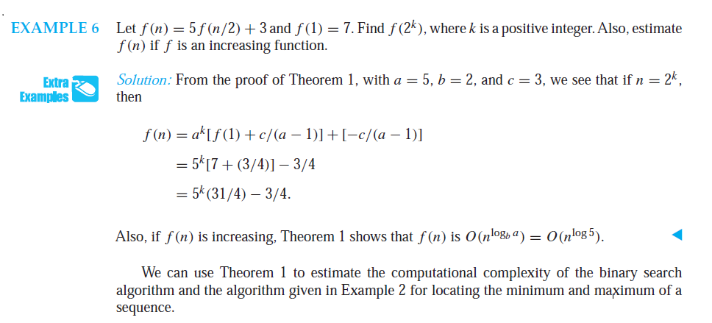

Slide 10

Complexity of Binary Search
Binary Search Example: Give a big-O estimate for the number of comparisons used by a binary search.
Solution: Since the number of comparisons used by binary search is f(n) = f(n/2) + 2 where n is even, by Theorem 1, it follows that f(n) is O(log n).

Slide 11


Estimating the Size of Divide-and-conquer Functions (continued)
Theorem 2. Master Theorem: Let f be an increasing function that satisfies the recurrence relation
f(n) = af(n/b) + cn^{d}
whenever n = b^{k}, where k is a positive integer greater than 1, and c and d are real numbers with c positive and d nonnegative. Then

Slide 12

Complexity of Merge Sort
Merge Sort Example: Give a big-O estimate for the number of comparisons used by merge sort.
Solution: Since the number of comparisons used by merge sort to sort a list of n elements is less than M(n) where M(n) = 2M(n/2) + n, by the master theorem M(n) is O(n log n).

Slide 13
Complexity of Fast Integer Multiplication Algorithm
Integer Multiplication Example: Give a big-O estimate for the number of bit operations used needed to multiply two n-bit integers using the fast multiplication algorithm.
Solution: We have shown that f(n) = 3f(n/2) + Cn, when n is even, where f(n) is the number of bit operations needed to multiply two n-bit integers. Hence by the master theorem with a = 3, b = 2, c = C, and d = 0 (so that we have the case where a > b^{d}), it follows that f(n) is O(n^{log 3}).
Note that log 3 ≈ 1.6. Therefore the fast multiplication algorithm is a substantial improvement over the conventional algorithm that uses O(n²) bit operations.

Slide 14
Generating Functions
Generating functions can be used to solve many types of counting problems.
number of ways to select or distribute objects of different kinds, subject to a variety of constraints.
number of ways to make change for a dollar using coins of different denominations.
Generating functions can be used to solve recurrence relations by translating a recurrence relation for the terms of a sequence into an equation involving a generating function.
This equation can then be solved to find a closed form for the generating function.
From this closed form, the coefficients of the power series for the generating function can be found, solving the original recurrence relation.

Slide 15




Generating Functions
Definition: The generating function for the sequence a₀, a₁,
…, a_{k}, … of real numbers is the infinite series
Examples:
The sequence {a_{k}} with a_{k} = 3 has the generating function
The sequence {a_{k}} with a_{k} = k + 1 has the generating function has the generating function
The sequence {a_{k}} with a_{k} =2^{k} has the generating function

Slide 16

Generating Functions for Finite Sequences
Generating functions for finite sequences of real numbers can be defined by extending a finite sequence a₀,a₁, … , a_{n} into an infinite sequence by setting
a_{n+1} = 0, a_{n+2} = 0, and so on.
The generating function G(x) of this infinite sequence
{a_{n}} is a polynomial of degree n because no terms of the
form a_{j}x^{j} with j > n occur, that is,
G(x) = a₀ + a₁x + …⋯ + a_{n} x^{n}.

Slide 17

Generating Functions for Finite Sequences (continued)
Example: What is the generating function for the sequence 1,1,1,1,1,1?
Solution: The generating function of 1,1,1,1,1,1 is 1 + x + x² + x³ + x⁴ + x⁵.
we have (x⁶ − 1)/(x −1) = 1 + x + x² + x³ + x⁴ + x⁵
when x ≠ 1.
Consequently G(x) = (x⁶ − 1)/(x −1) is the generating function of the sequence.

Slide 18
Useful Facts About Power Series
EXAMPLE 4
The function f (x) = 1/(1 − x) is the generating function of the sequence 1, 1, 1, 1, . . . , because
1/(1 − x) = 1 + x + x2 +· · ·
for |x| < 1.
EXAMPLE 5
The function f (x) = 1/(1 − ax) is the generating function of the sequence 1, a, a2, a3, . . . ,because
1/(1 − ax) = 1 + ax + a2x2 +· · ·
when |ax| < 1, or equivalently, for |x| < 1/|a| for a = 0.

Slide 19
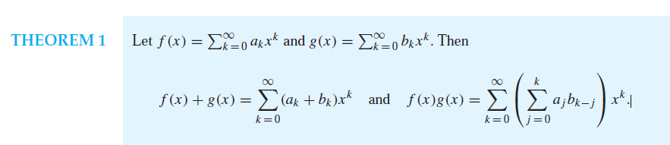
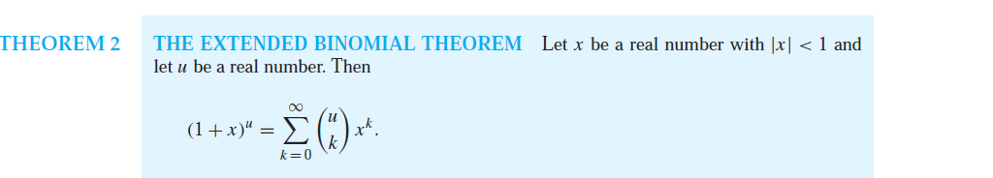
Useful Facts About Power Series

Slide 20
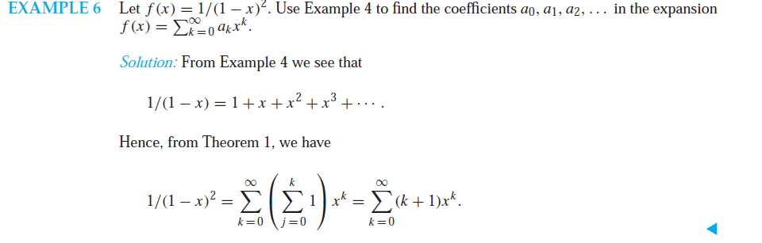

Slide 21
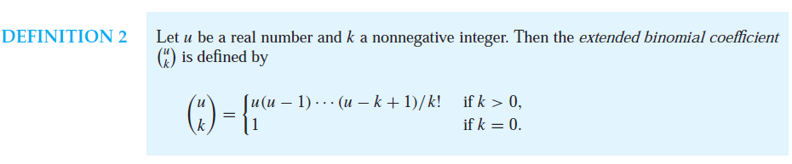
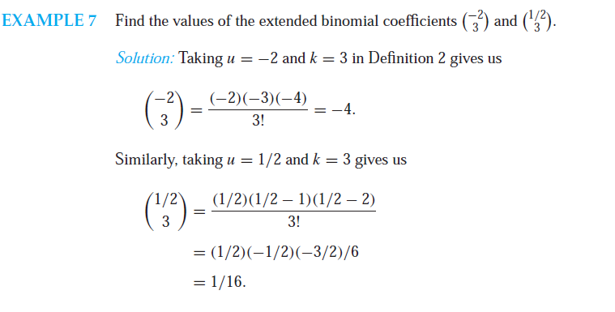

Slide 22
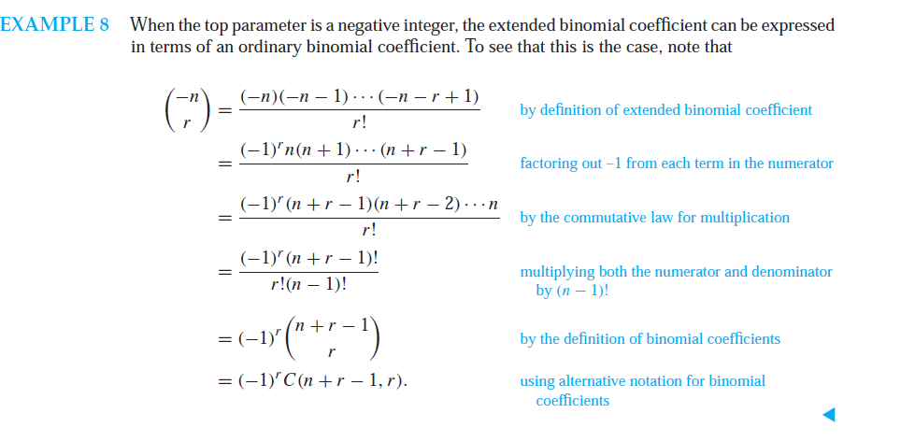

Slide 23
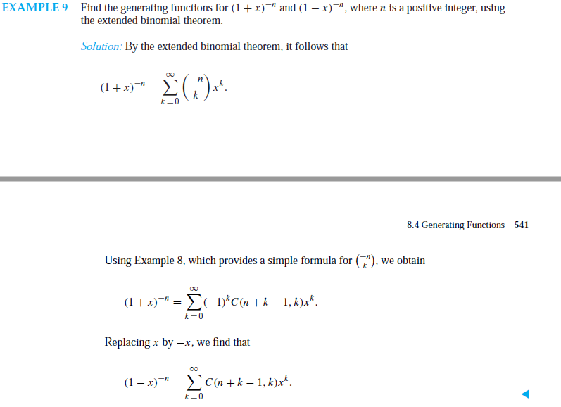

Slide 24
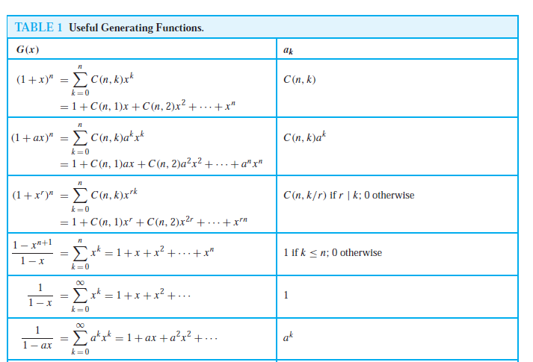

Slide 25
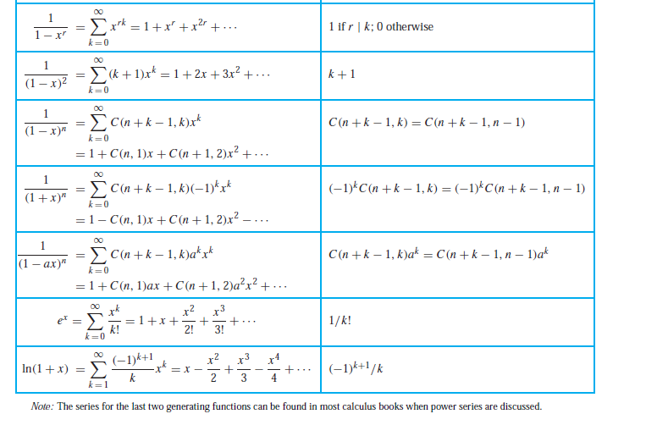

Slide 26

Counting Problems and Generating Functions
Generating functions used to count the number of combinations of various types.
Counting the solutions to equations of the form e₁ + e₂ +· · ·+e_{n} = C,
where C is a constant and each e_{i} is a nonnegative integer.
Example: Find the number of solutions of e₁ + e₂ + e₃ = 17,
where e₁, e₂, and e₃ are nonnegative integers with
2 ≤ e₁≤ 5, 3 ≤ e₂ ≤ 6, and 4 ≤ e₃ ≤ 7.
Solution: The number of solutions is the coefficient of x¹⁷ in the expansion of
(x² + x³ + x⁴ + x⁵) (x³ + x⁴ + x⁵ + x⁶) (x⁴ + x⁵ + x⁶ + x⁷).
This follows because a term equal to is obtained in the product by picking a term in the first sum x^{e1}, a term in the second sum x^{e2}, and a term in the third sum x^{e3}, where e₁ + e₂ + e₃ = 17.
There are three solutions since the coefficient of x¹⁷ in the product is 3.

Slide 27
EXAMPLE
In how many different ways can eight identical cookies be distributed among three distinct children if each child receives at least two cookies and no more than four cookies?
Solution:
Because each child receives at least two but no more than four cookies, for each child there is a factor equal to (x² + x³ + x⁴)
in the generating function for the sequence {cn}, where cn is the number of ways to distribute n cookies.
Because there are three children, this generating function is
(x² + x³ + x⁴)³.
We need the coefficient of x⁸ in this product.
x⁸ terms in the expansion correspond to the ways that three terms can be selected.
Computation shows that this coefficient equals 6

Slide 28



Counting Problems and Generating Functions (continued)
Example: Use generating functions to find the number of k-combinations of a set with n elements, i.e., C(n,k).
Solution: Each of the n elements in the set contributes the term (1 + x) to the generating function
Hence f(x) = (1 + x)^{n} where f(x) is the generating function for {a^{k}}, where a^{k}
represents the number of k-combinations of a set with n elements.
By the binomial theorem, we have
where
Hence,

Slide 29
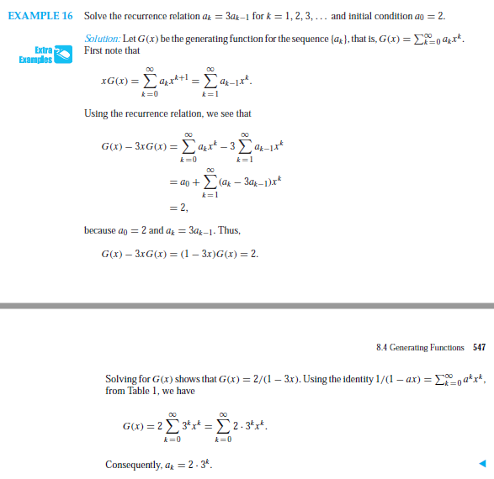
Using Generating Functions to Solve Recurrence Relations

Slide 30
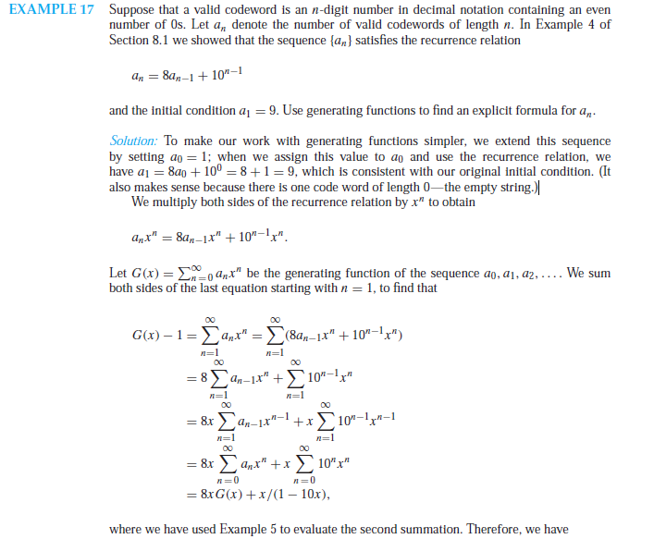

Slide 31
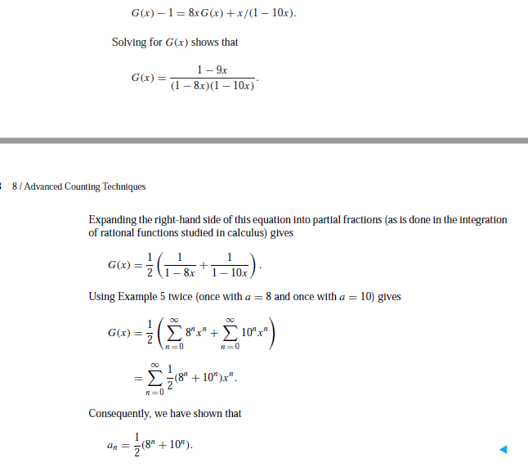

Slide 32

Inclusion-Exclusion
Section 8.5

Slide 33
Principle of Inclusion-Exclusion
In Section 2.2, we developed the following formula for the number of elements in the union of two finite sets:
We will generalize this formula to finite sets of any size.

Slide 34
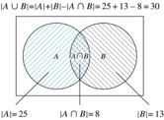
Two Finite Sets
Example: In a discrete mathematics class every student is a major in computer science or mathematics or both. The number of students having computer science as a major (possibly along with mathematics) is 25; the number of students having mathematics as a major (possibly along with computer science) is 13; and the number of students majoring in both computer science and mathematics is 8. How many students are in the class?
Solution: |A∪B| = |A| + |B| −|A∩B|
= 25 + 13 −8 = 30
The Set of Students in a
Discrete Mathematics Class.

Slide 35

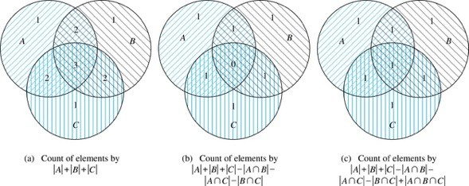
Three Finite Sets

Slide 36
Three Finite Sets Continued
Example: A total of 1232 students have taken a course in Spanish, 879 have taken a course in French, and 114 have taken a course in Russian. Further, 103 have taken courses in both Spanish and French, 23 have taken courses in both Spanish and Russian, and 14 have taken courses in both French and Russian. If 2092 students have taken a course in at least one of Spanish French and Russian, how many students have taken a course in all 3 languages.
Solution: Let S be the set of students who have taken a course in Spanish, F the set of students who have taken a course in French, and R the set of students who have taken a course in Russian. Then, we have
|S| = 1232, |F| = 879, |R| = 114, |S∩F| = 103, |S∩R| = 23, |F∩R| = 14, and
|S∪F∪R| = 23.
Using the equation
|S∪F∪R| = |S|+ |F|+ |R| − |S∩F| − |S∩R| − |F∩R| + |S∩F∩R|, we obtain 2092 = 1232 + 879 + 114 −103 −23 −14 + |S∩F∩R|.
Solving for |S∩F∩R| yields 7.

Slide 37

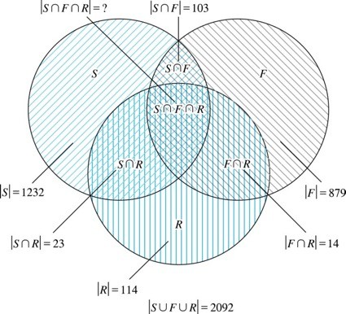
Illustration of Three Finite Set Example

Slide 38


The Principle of Inclusion-Exclusion
Theorem 1. The Principle of Inclusion-Exclusion: Let A₁, A₂, …, A_{n} be finite sets. Then:

Slide 39

The Principle of Inclusion-Exclusion (continued)
Proof: An element in the union is counted exactly once in the right-hand side of the equation. Consider an element a that is a member of r of the sets A₁,…., A_{n}
where 1≤r ≤n.
It is counted C(r,1) times by Σ|A_{i}|
It is counted C(r,2) times by Σ|A_{i} ⋂A_{j}|
In general, it is counted C(r,m) times by the summation of m of the sets A_{i}.

Slide 40

The Principle of Inclusion-Exclusion (cont)
Thus the element is counted exactly
C(r,1) − C(r,2) + C(r,3) − …⋯ + (−1)^{r+1} C(r,r)
times by the right hand side of the equation.
By Corollary 2 of Section 6.4, we have
C(r,0) − C(r,1) + C(r,2) − …⋯ + (−1)^{r} C(r,r) = 0.
Hence,
1 = C(r,0) = C(r,1) − C(r,2) + …⋯ + (−1)^{r+1} C(r,r).

Slide 41

Applications of Inclusion-Exclusion
Section 8.6

Slide 42

Section Summary
The Sieve of Eratosthenes
Counting Onto-Functions
Derangements

Slide 43
The Sieve of Eratosthenes
find all primes less than a specified positive integer n
find the number of primes not exceeding 100
Composite integers not exceeding 100 must have a prime factor not exceeding 10.
primes not exceeding 10 are 2, 3, 5, and 7
Thus, the number of primes not exceeding 100 is
4 + N(P’₁P’₂P’₃P’₄).

Slide 44
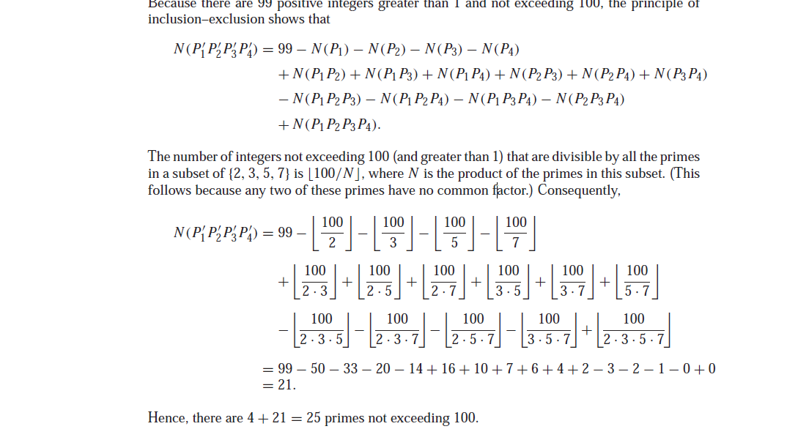

Slide 45
The Number of Onto Functions
Example: How many onto functions are there from a set with six elements to a set with three elements?
Solution: Suppose that the elements in the codomain are b₁, b₂, and b₃. Let P₁, P₂, and P₃ be the properties that b₁, b₂, and b₃ are not in the range of the function, respectively. The function is onto if none of the properties P₁, P₂, and P₃ hold.
By the inclusion-exclusion principle the number of onto functions from a set with six elements to a set with three elements is
N − [N(P₁) + N(P₂) + N(P₃)] +[N(P₁P₂) + N(P₁P₃) + N(P₂P₃)] − N(P₁P₂P₃)
Here the total number of functions from a set with six elements to one with three elements is N = 3⁶.
The number of functions that do not have in the range is N(P₁) = 2⁶. Similarly, N(P₂) = N(3₁) = 2⁶ .
Note that N(P₁P₂) = N(P₁P₃) = N(P₂P₃) = 1 and N(P₁P₂P₃)= 0.
Hence, the number of onto functions from a set with six elements to a set with three elements is: 3⁶ − 3· 2⁶ + 3 = 729 − 192 + 3 = 540

Slide 46
The Number of Onto Functions (continued)
Theorem 1: Let m and n be positive integers with
m ≥ n. Then there are
onto functions from a set with m elements to a set with n elements.

Slide 47

Derangements
Definition: A derangement is a permutation of objects that leaves no object in the original position.
Example: The permutation of 21453 is a derangement of 12345 because no number is left in its original position. But 21543 is not a derangement of 12345, because 4 is in its original position.

Slide 48


Derangements (continued)
Theorem 2: The number of derangements of a set with n elements is
Let Ai be the number of permutations that number i is in position i. Number of dearrangements is n!-|A1 ∪ A2 ∪ A3 ∪ A4….. ∪ An| Then |Ai|=(n-1)!,
|Ai ⋂ Aj|=(n-2)!
|Ai1⋂ Ai2⋂ Ai3……⋂ Aik|=(n-k)!

Slide 49



Derangements (continued)
The Hatcheck Problem: A new employee checks the hats of n people at restaurant, forgetting to put claim check numbers on the hats. When customers return for their hats, the checker gives them back hats chosen at random from the remaining hats. What is the probability that no one receives the correct hat.
Solution: The answer is the number of ways the hats can be arranged so that there is no hat in its original position divided by n!, the number of permutations of n hats.
Remark: It can be shown that the probability of a derangement approaches 1/e as n grows without bound.

